Slide 1

Final project Bianca Finol

Slide 2
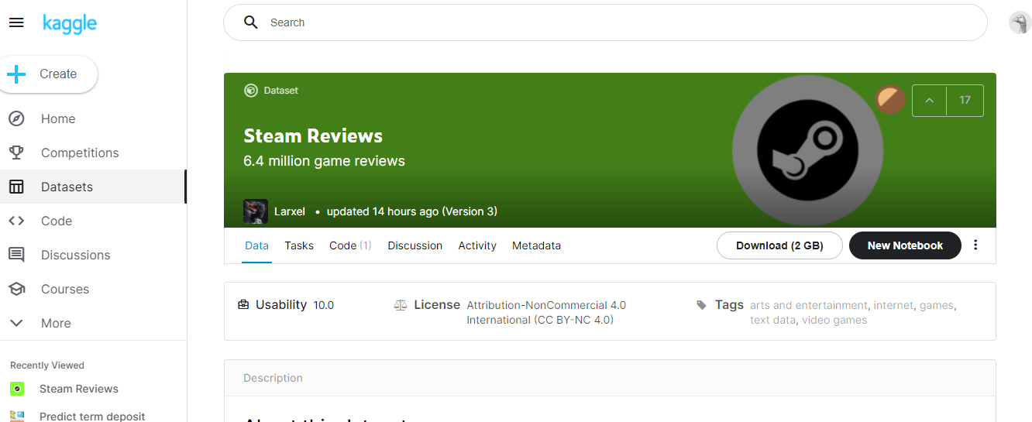
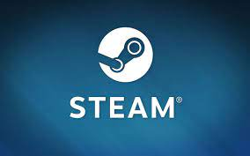
Dataset
The dataset contains over 6.4 million publicly available reviews
Steam is a video game digital distribution service

Slide 3
Agenda
Define problem statement
Get and extract data
Parse and filter text
Transform text
Structure and explore text
Visualize and analyze text
Business Analytics process

Slide 4
Business problem
Define problem statement
Identify the video game with more negative reviews and evaluate whether it can be improved or removed from the platform

Slide 5

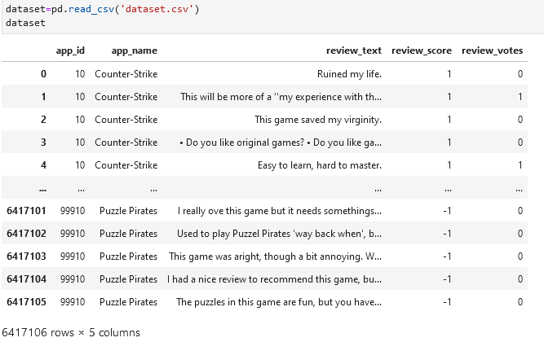
What is inside of the dataset.

Slide 6
feature extraction
Get and extract data
Basic feature extraction using text data
Number of words
Number of characters
Average word length
Number of stopwords

Slide 7
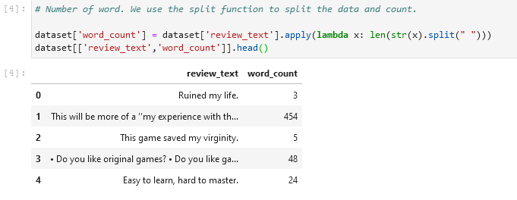
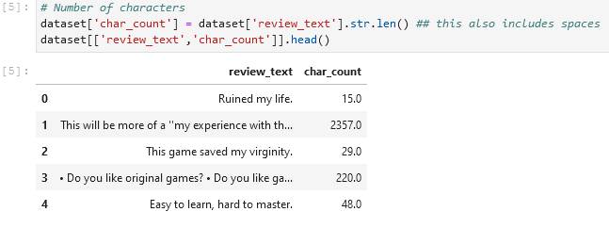
# Number of words and characters

Slide 8
Cleaning data
Parse and filter text
Basic Text Pre-processing of text data
Lower casing
Punctuation removal
Stopwords removal
Spelling correction
Tokenization
Stemming
Lemmatization

Slide 9
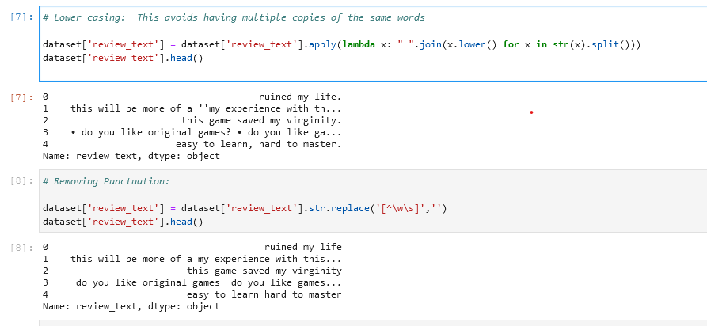
Lower casing and removing punctuation
Transforming all words in lower case avoid multiple copies of the same words.
Removing punctuation helps to reduce the size of the training data

Slide 10
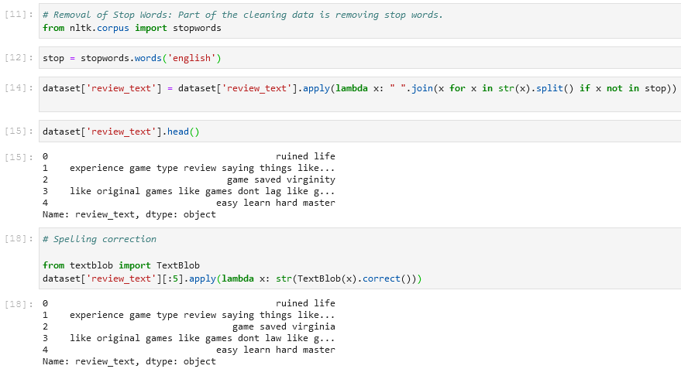
Removing stop word and spelling correction
Remove stop words
Spelling correction

Slide 11
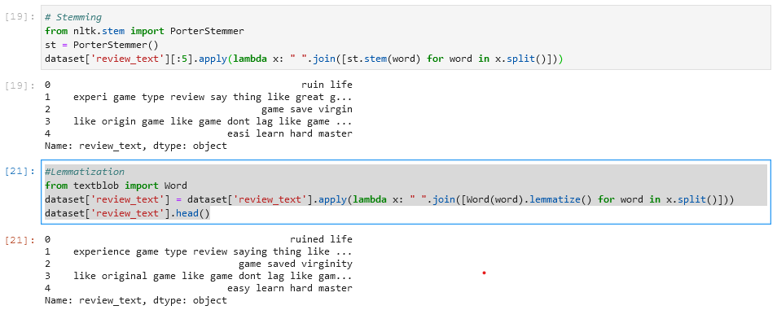
Stemming and lemmatization
Stemming
Lemmatization

Slide 12
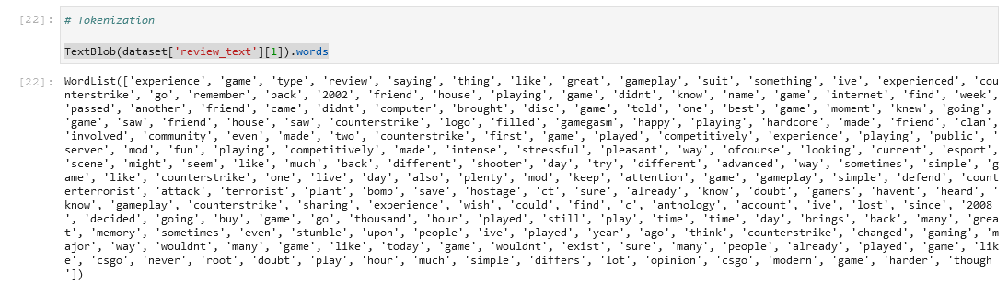
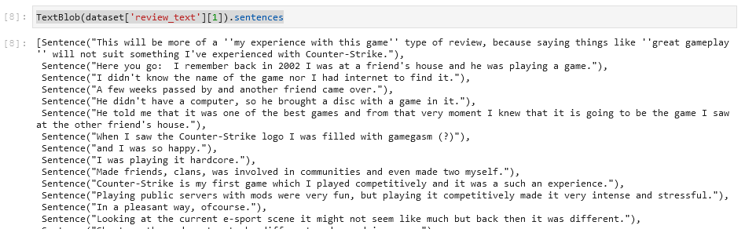
Tokenization: words and sentences
Words
Sentences

Slide 13
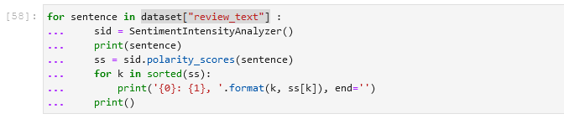
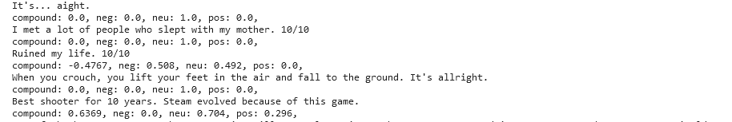
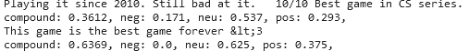
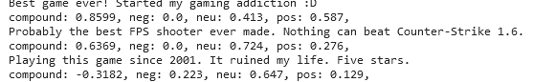
Sentiment Analyzer
Analysis based on some sentences

Slide 14

Analysis

Slide 15
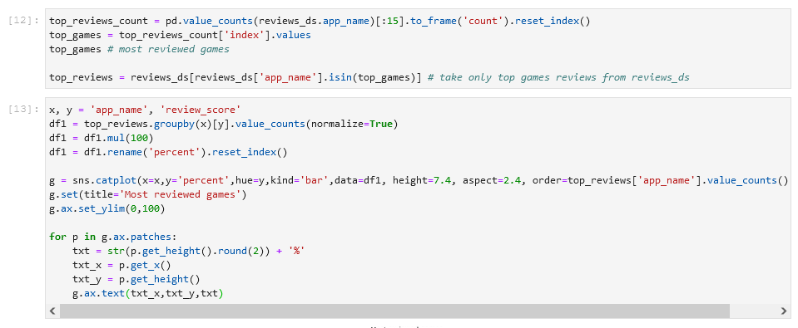
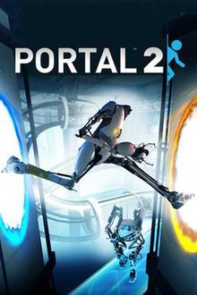
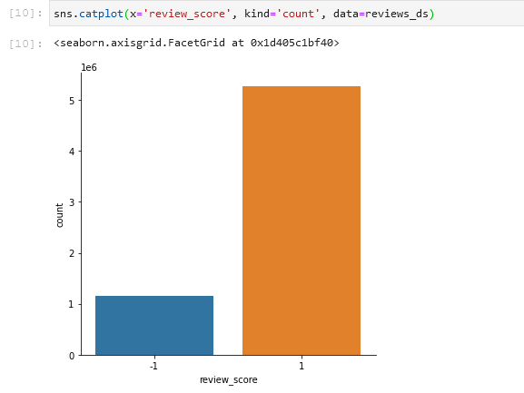
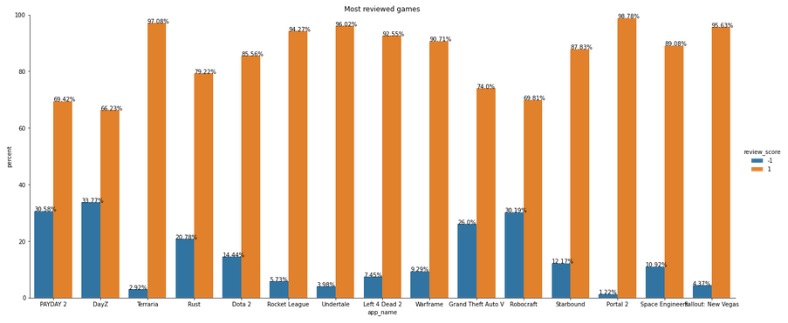
Most recommended game Portal 2
Review Score: whether the game the review recommends the game or not.

Slide 16
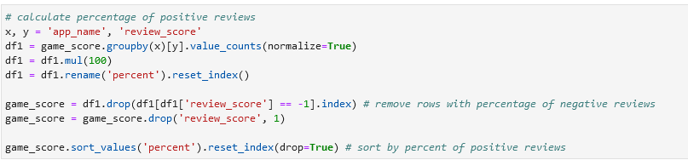
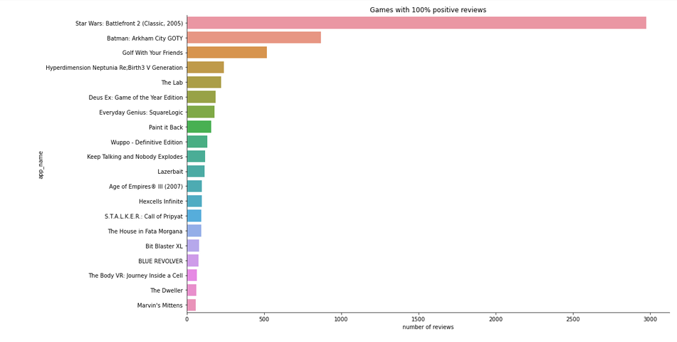
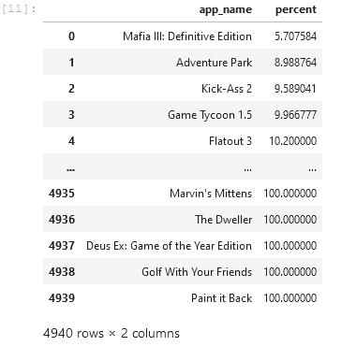
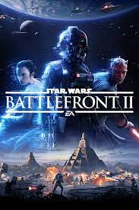
Positive Reviews
Star Wars: Battlefront 2 favorite with 3K reviews

Slide 17
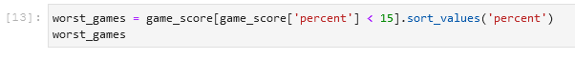
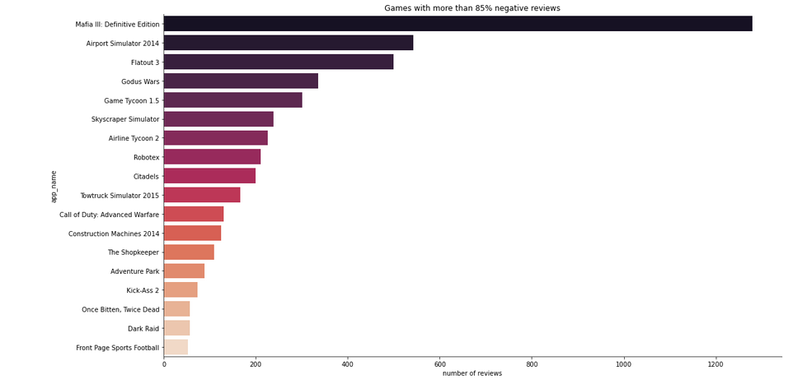
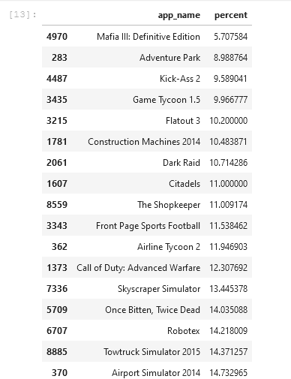
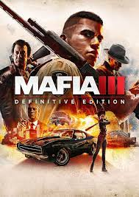
Worst reviews
Worst review for Mafia III with 1.2K bad reviews

Slide 18
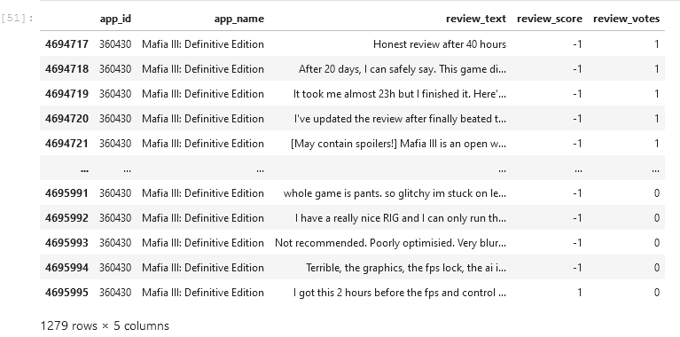
Sentiment analysis Mafia III: Definitive Edition

Slide 19
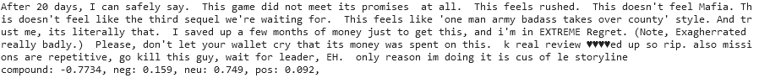
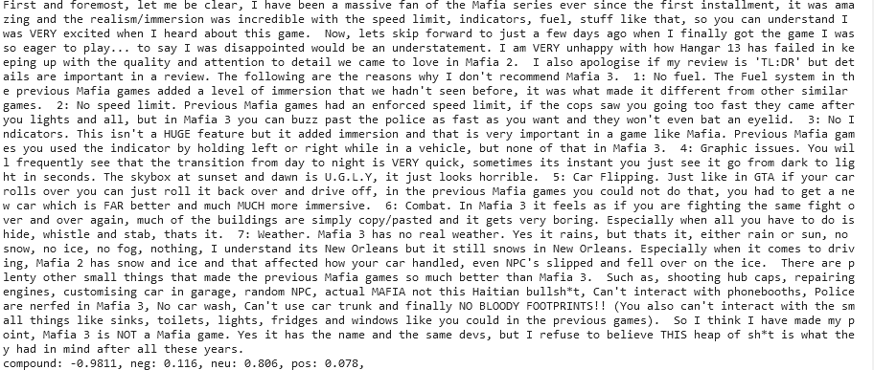
Compound negative in most reviews
A disappointed fan

Slide 20
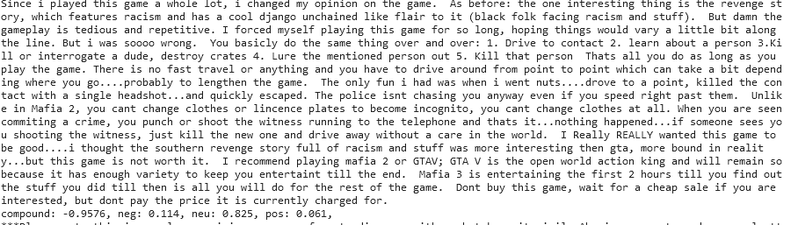
Compound negative in most reviews
Some reviews are related to price

Slide 21
Conclusion
There are good overall feedbacks about the games on the platform.
Star Wars: Battlefront 2 is the game with the best review
Mafia III is the game with the worst review
Many fans of Mafia are disappointed with this version.
The sentiment analysis of the review comments for Mafia III is negative.
The business should evaluate if Mafia III is profitable or there is some strategic value to keep it on the platform.

Slide 22
Thank you

